Slide 1
Software Development Methodology
School of Computing and Engineering

Slide 2
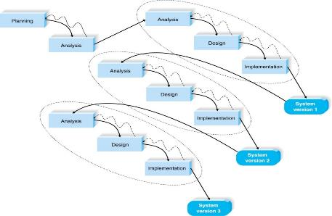
Software Development Methodology
When planning the software, it is also decided what software development methodology should be used…

Slide 3
System Development Methodology (SDM)
SDLC provide the foundation for the processes used to develop the system
A system development methodology is the approach used to implementing the SDLC.
SDM forms a list of steps and deliverables.
There are many different systems development methodologies, and they vary in terms of progression
However, they all follow four fundamental phases (planning, analysis, design, and implementation).

Slide 4
General Advantages of A Methodology
SDM ensures a consistent reproducible approach is used
It reduces the risks associated with shortcuts and mistakes
It produces consistent documentation from one project to the next
As development teams change over time, the results of past work can be easily understood and modified.

Slide 5
Types of Systems Development Methodology
There are many system development methodologies:
- Waterfall Development Methodology
- Parallel Development Methodology
- V-model Methodology (variation of the Waterfall and Parallel)
- Rapid Application Development (RAD)
- Iterative Development Parallel
- Based on the fundamentals of system prototyping
- Agile Development Methodology

Slide 6
Software Development Methodology
1. Traditional Structured Analysis & Design Methodologies
Waterfall Model
Parallel Development
V-model
2. Modern Iterative Prototyping Methodologies
Rapid Application Development (RAD): Iterative & Throwaway Prototyping
Agile Development:

Slide 7
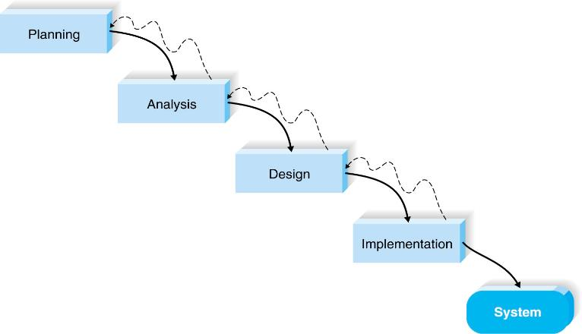
Waterfall Development

Slide 8
Waterfall
Development proceeds sequentially from one phase to the next.
Once the work produced in one phase is approved, the phase ends and the next phase begins.
As the project progresses from phase to phase it is difficult to go backward through phases.
Advantage:
Requirements are identified before development
Disadvantage:
The design must be completely specified before programming begins.

Slide 9
From Waterfall to Parallel Development
In Waterfall:
important requirements can be overlooked and missed
Users may forget the original purpose of the system and there is so much time between planning and implementation.
To address this, requires going back to the initial phase and making needed changes through each of the subsequent phases in turn.
The parallel development methodologies evolved to address the limitations in the Waterfall’s method.

Slide 10
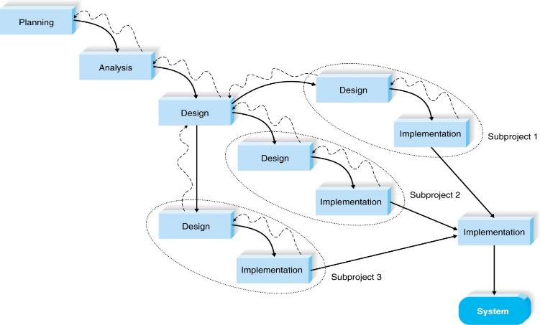
Parallel Development

Slide 11
Parallel Development
Instead of doing the design and implementation in sequence, a general design for the whole system is performed.
The project is divided into a series of subprojects that run in parallel.
Once all subprojects are complete there is a final integration, and the system is delivered.

Slide 12
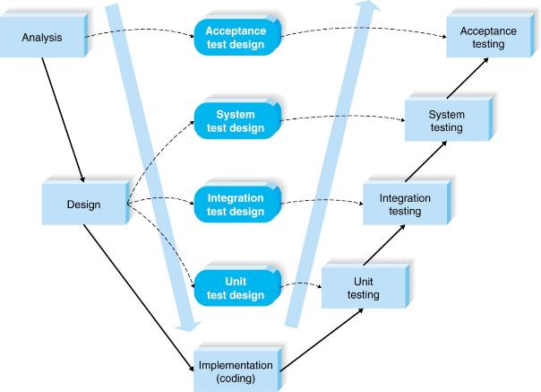
V-model

Slide 13
V-model
The V-model is another variation of waterfall method that focuses on testing.
The development processes on the left-hand slope of the V defines requirements and components
Requirements are specified and components are designed, with adjacent testing also defined.
The code is written at the base. On the right upward-slope, the model tests the components.
Each level of testing is linked to a part of the analysis or design phase.

Slide 14

Drawback to V-model
It still suffers from the inflexibility of the waterfall development process and is not always appropriate for the dynamic nature of business due to rapid change

Slide 15
Rapid Application Development (RAD)
RAD incorporates special techniques and computer tools to speed up the SDLC phases in order to get evaluation and feedback:
CASE (Computer-Aided Software Engineering) tools;
JAD (Joint Application development) sessions;
High level Programming Languages.
Users’ expectations can be identified, and system requirements may expand during the project.
RAD can be conducted using:
Iterative development
System prototyping
Throwaway prototyping (system is built quickly to gather feedback)

Slide 16
What is JAD?

Slide 17
Answer
Joint Application Design (JAD) is a group process involving users and systems development staff in which all parties discuss the needs for an information system and reach a shared understanding. [2]

Slide 18

RAD: Iterative Development

Slide 19
Iterative development
Breaks the overall project into a series of versions that are developed sequentially.
The most important and fundamental requirements are bundled into the first version of the system.
This version is developed quickly by a mini-waterfall process and once implemented the users can provide valuable feedback to be incorporated into the next version of the system.

Slide 20
What is prototyping?

Slide 21
Answer
Prototyping is an iterative process of systems development by which requirements are converted to a working system, which is continually revised through close work between an analyst and users.
A system prototype is a quick version of the system and provides minimal features.

Slide 22
System Prototyping
Performs analysis, design and implementation phases concurrently to quickly develop a simplified version of the proposed system to get feedback
Following the reaction and feedback form users the developers re-analyse, re-design, and re-implement a second prototype. These prototypes evolve, forming the final system.
This cycle continues until the analysts, users and sponsor agree that the prototype provides enough functionality to be installed and used
Disadvantage: The main disadvantage is the lack of careful analysis before the design and implementation phase

Slide 23
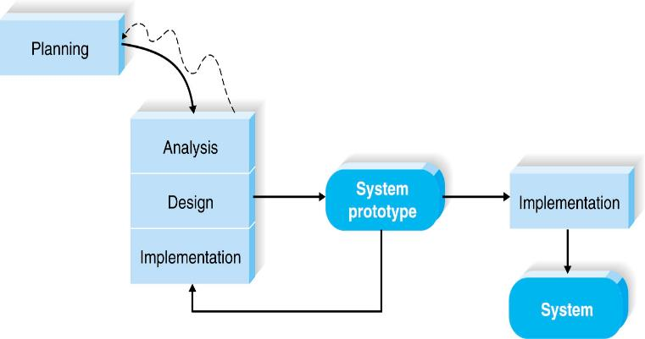
RAD: System Prototyping

Slide 24
Agile Development
Agile is a group of programming-centric methodologies that focus on streamlining the SDLC.
Agile includes face-to-face communication.
There are several popular approaches to agile development including:
Extreme programming
Scrum
Dynamic Systems Development Method (DSDM)

Slide 25
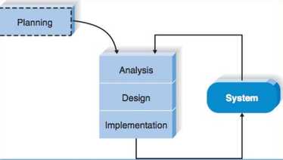
Agile Development
Agile was created because of dissatisfaction with the sequential, processes of waterfall-based approaches.
Agile is an iterative methodology. For every iteration, a completed software project, including planning, requirements analysis, design, coding, testing and documentation is undertaken.
Agile cycles are short (1-4 weeks) and the development team focuses on adapting to the current business environment.

Slide 26
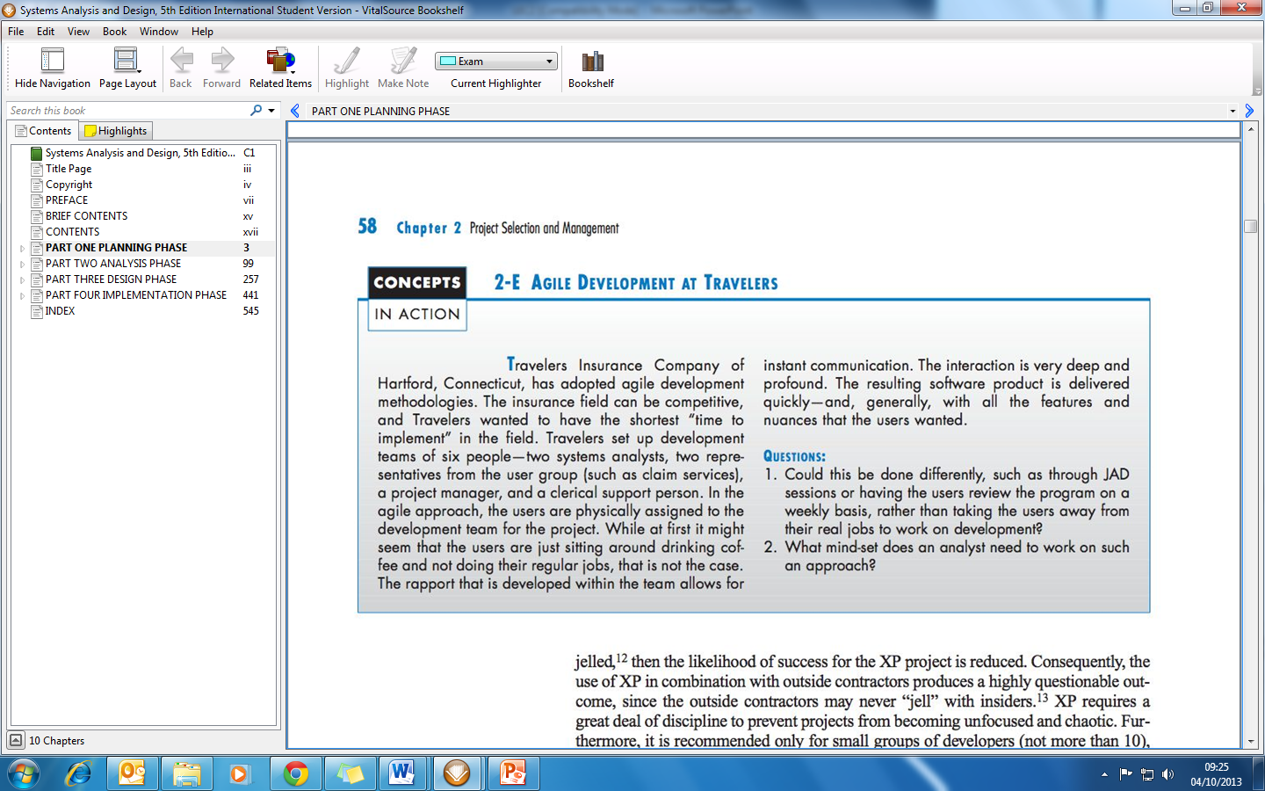
Class Discussion

Slide 27
Possible answers
The projects certainly could be done with JAD sessions or with having the users review the project on a weekly basis. However, the success of an agile development depends upon the cohesiveness of the team, typically accomplished by having users meet and devote all their time to the project so that they are able to communicate ideas, comments, suggestions, and providing feedback immediately.
In order to work on an agile development project, an analyst needs to be highly motivated, dedicated to the project, able to communicate effectively, and work well in a high-paced team environment.

Slide 28
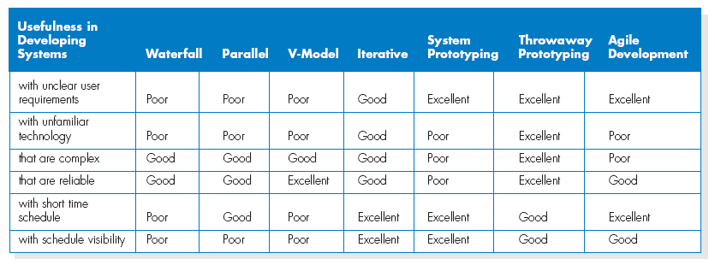
Selecting the Appropriate Development Methodology

Slide 29
References
Dennis, A., and Wixom, B. H, “Systems Analysis and Design”, 5th Edition, John Wiley & Sons (2013), Chapter two.
Hoffer, V.G. “Essentials of Systems Analysis & Design”, 5th Edition, Pearson (2014)

